Slide 1
Integrating Patient Values into Clinical Trials Using a Patient-Centered Composite Endpoint: A Case Study Using the Control of Hypertension in Pregnancy Study (CHIPS) Trial
Rebecca Metcalfe^{1,2}, Nick Bansback^{1,2}, Mark Harrison^{1,2}, Mary Lewisch³, Terry Lee², Joel Singer ^{1,2}, Laura Magee⁴, Peter von Dadelszen⁴
1. University of British Columbia, Vancouver, Canada; 2. Centre for Health Evaluation and Outcome Sciences Vancouver, Canada; 3. Patient Partner; 4. King’s College London

Slide 2
Disclosures and Acknowledgments
None of the authors have any disclosures
This work would not have been possible without a large team of patient partners, and other researchers
The study was funded by the BC SUPPORT Unit, and the Canadian Institutes of Health Research (CIHR) both federally funded organizations
Colleagues have critically reviewed previous versions of slides to mitigate potential bias
The work was conducted on the traditional and unceded territory of the Coast Salish Peoples, including the territories of the xwməθkwəy̓əm (Musqueam), Skwxwú7mesh (Squamish), Stó:lō and Səl̓ílwətaʔ/Selilwitulh (Tsleil- Waututh) Nations

Slide 3
Composite endpoints
Severe High Blood Pressure
Have many benefits – reduce type 1 errors, increase statistical efficiency/power, covers the clinical course
But have limitations – outcomes do not occur at the same rate, but are effectively weighted the same
Death
Heart
Attacks
Notes:
These events are not all equally important
But an event is an event
Outcomes do not occur at the same rate

Slide 4
Aim
33%
15%
Clinical Measurement
33%
50%
Integrate patient preferences into trial analyses to make trial results easier to understand and easier to use
Death
Acute
Outcome
33%
35%

Slide 5
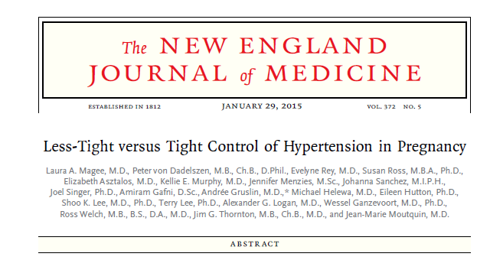
Case Study: The CHIPS Trial
International, open, pragmatic RCT
~1000 individuals
Comparing two treatment approaches
‘Tight’ Control
Intervene now
‘Less-tight’ Control
Wait and see

Slide 6
Case Study: The CHIPS Trial
Composite outcome:
Secondary Outcomes:
Severe high blood pressure
Baby born smaller than expected
Infant
Death
High Level
of
Neonatal
Care

Slide 7
Case Study: The CHIPS Trial
Composite outcome:
Secondary Outcomes:
Severe high blood pressure
Baby born smaller than expected
Infant
Death
High Level
of
Neonatal
Care
Tight Control Better
Less-Tight Control Better
No Difference
Revised Clinical Guideline:
Tight’ control of pregnancy hypertension
AND
Care providers should consider patient preferences

Slide 8
What did we do?
1
2
3
Talked to patients to find out what they prioritize when making this health care decision
Used a survey to quantify the importance of each outcome to patients
Integrated survey results into the trial analysis using a patient-oriented composite and patient-oriented weights
Hargraves IG & Montori V JAMA Intern Med 2019; Solomon MZ et al. Health Aff 2016;
Notes:
Physicians often assume patients have the same preferences as them; patients are experiencing the outcomes, and patient-oriented care improves adherence, engagement and satisfaction
Patients prioritize different outcomes than clinicians and researchers
Patients are the most impacted by trial results because they experience the interventions and the outcomes

Slide 9
What did we do?
Patients Prioritized Avoiding
7 Outcomes & Interventions:
Severe high blood pressure
Pre-eclampsia
Baby born before 34 weeks
Baby born smaller than expected
Taking blood pressure medication
Blood transfusion
Caesarean delivery
1
Talked to patients to find out what they prioritize when making this health care decision

Slide 10
What did we do?
Identified 3 Preferences Profiles
Profile 1: No clear
Priority
2
Profile 2: Avoid Early
Delivery
Used a survey to quantify how important each of those outcomes
Profile 3: Minimize
Medication
Metcalfe RK, et al. Patient preferences and decisional needs when choosing a treatment approach for pregnancy hypertension: a stated preference study. Canadian Journal of Cardiology. 2020 1;36(5):775-9.

Slide 11
What did we do?
 | Profile 1 No Clear Priority | Profile 2 Avoid Early Delivery | Profile 3 Minimize Medication
Severe High Blood Pressure | 0.11 | 0.20 | 0.20
Pre-eclampsia | 0.15 | 0.16 | 0.10
Delivery <34 weeks | 0.18 | 0.42 | 0.02
Born smaller than expected | 0.08 | 0.16 | 0.05
Taking Medication | 0.14 | 0.02 | 0.58
Blood Transfusion | 0.20 | 0.02 | 0.00
Caesarean Delivery | 0.13 | 0.02 | 0.04
2
Used a survey to quantify how important each of those outcomes

Slide 12
What did we do?
Hypothetical Participant
3
Pre-eclampsia
No
Taking medication
Yes
Early
Delivery
Yes
Did the outcome occur?
0
1
1
20%
65%
15%
How important is the outcome?
Integrated survey results into the trial analysis using a patient-oriented composite and patient-oriented weights
Sum
0.0
.65
.15
Multiply through
= 0.8
Approach adapted from Ahmad et al.’s approach for meta-analyses; Ahmad Y et al. Int J Cardiol. 2015
Notes:
Using this approach, lower scores are better because they indicate that fewer highly weighted events occurred

Slide 13
What did we do?
Participant Number | Weighted Outcome Score | Treatment Arm
1 | 0.50 | Tight Control
2 | 0.65 | Tight Control
3 | 0.45 | Less Tight Control
4 | 0.90 | Tight Control
5 | 0.50 | Less Tight Control
6 | 0.70 | Less Tight Control
Mean:
0.68
Mean:
0.53

Slide 14
Results: Primary
**
*
No Clear Priority
Avoid Early Delivery
Minimize Medication
Notes:
Ultimately, this may improve shared-decision making by 1) identifying the main ways that values differ among women with pregnancy hypertension and making it easier for doctors to understand which treatments align with different value sets or preference profiles.

Slide 15
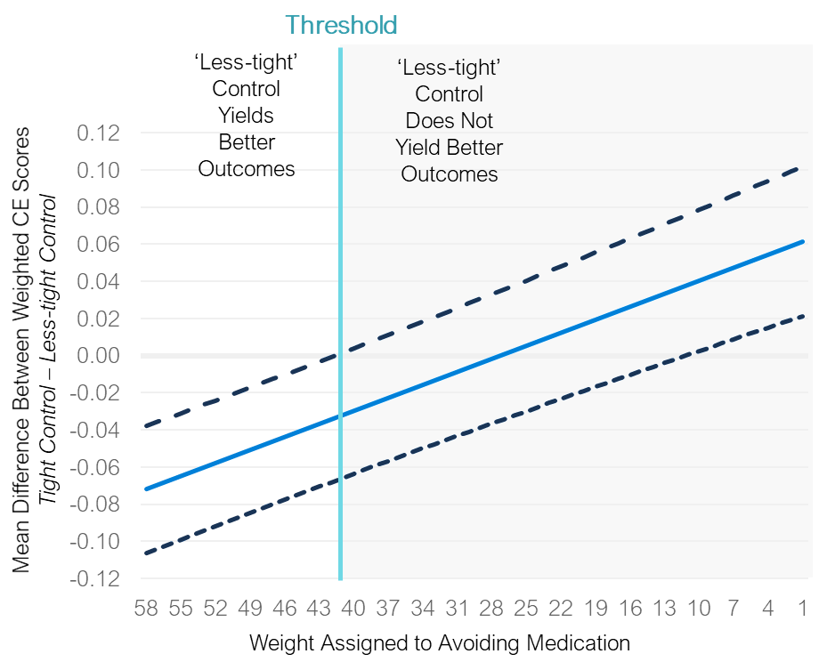
Results: Threshold Analysis
For individuals who prioritize avoiding medication, ‘less-tight’ control yields better outcomes as long as avoiding medication makes up two fifths of the decision or more
Which treatment approach is best for any given person depends on which outcomes they prioritise and to what degree.

Slide 16
Discussion: Strengths
This is the first study in pregnancy to integrate patient value weights into individual-level trial data
Used patient weights and a patient-oriented composite
Allowed the inclusion of treatment requirements not just outcomes
Addresses issues with traditional composite endpoints and aids in interpretation
Relatively simple statistical analysis
Can accommodate covariates; robust; parametric test

Slide 17
Discussion: Limitations
Implications for trial design and particularly power are unclear
May be best as a sensitivity analysis
May lose statistical efficiency that is gained by composite endpoints
Study done post-hoc
Did not use values of women in the trial

Slide 18
Future Directions
Need to stop treating composite endpoints with equal weights as value neutral
Future studies should consider how patient values can inform their analysis
Selection of outcomes
Weight of outcomes
Both?

Slide 19
Thank you
None of the authors have any disclosures
This work would not have been possible without a large team of patient partners, and other researchers
The study was funded by the BC SUPPORT Unit, and the Canadian Institutes of Health Research (CIHR) both federally funded organizations
Colleagues have critically reviewed previous versions of slides to mitigate potential bias
The work was conducted on the traditional and unceded territory of the Coast Salish Peoples, including the territories of the xwməθkwəy̓əm (Musqueam), Skwxwú7mesh (Squamish), Stó:lō and Səl̓ílwətaʔ/Selilwitulh (Tsleil- Waututh) Nations

